Slide 1
Lesson 6
TREATING PENETRATING
CHEST TRAUMA
AND
DECOMPRESSING A TENSION PNEUMOTHORAX

Slide 2
TASK
Treat a simulated casualty with penetrating chest trauma, including decompressing a tension pneumothorax.
CONDITIONS
Given a simulated conscious or unconscious casualty and a combat lifesaver medical equipment set.
STANDARDS
Score a GO on the performance checklists and additional injuries to the casualty are prevented.
REFERENCES
STP 21-1-1-SMCT, Soldier’s Manual of Common Task:
Skill Level 1. FM 4-25.11, First Aid

Slide 3
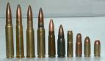
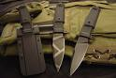
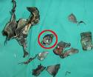
INTRODUCTION
When an object penetrates the chest wall, the injury is called an open chest wound.
The penetration can be caused by a bullet, knife blade, shrapnel, or other objects.

Slide 4
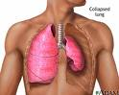
INTRODUCTION
Anytime there is an open
chest wound, there is danger of
the lung collapsing!
If an object punctures the chest wall and allows air to get in, the lung within that area begins to collapse.

Slide 5
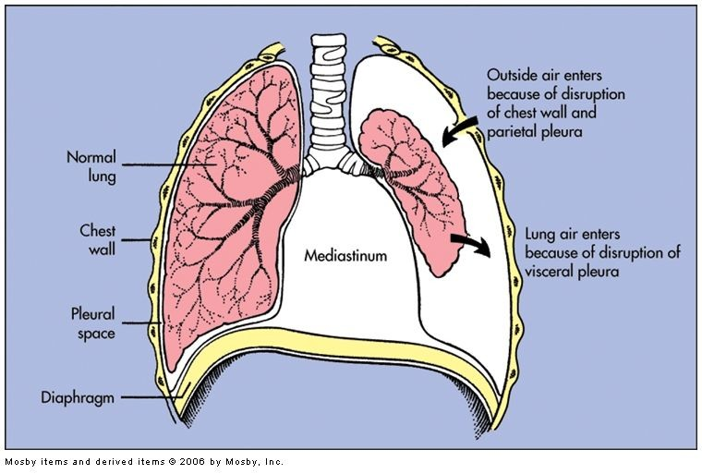
INTRODUCTION

Slide 6
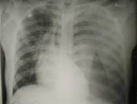
SIGNS OF OPEN CHEST WOUND
Sucking or hissing sounds coming from chest wound. When a casualty with an open chest wound breathes, air goes in and out of the wound, creating a "sucking" sound. This is why chest wounds are often called “sucking chest wounds.”

Slide 7
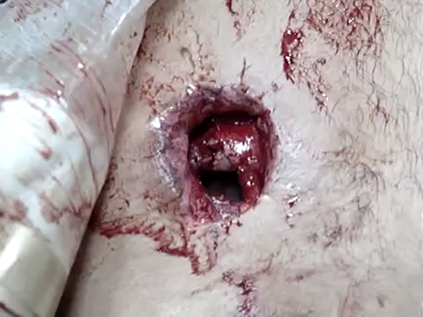
SIGNS & SYMPTOMS

Slide 8
SIGNS & SYMPTOMS
Casualty coughing up blood.
Frothy blood coming from the chest wound.
(The air going in and out of an open chest wound causes bubbles in the blood coming from the wound)
Shortness of breath or difficulty in breathing.
Chest not rising normally when the casualty inhales.

Slide 9
SIGNS & SYMPTOMS
Increasing pain in shoulder or chest area.
Bluish tint (cyanosis) of lips, inside of mouth, fingertips.
Rapid and weak heartbeat (shock).
If you are unsure if the chest has been penetrated, TREAT AS AN OPEN CHEST WOUND!

Slide 10
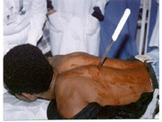
CHECK FOR OPEN CHEST WOUNDS
Put on gloves!!
Locate Wound (Evaluate the Casualty)
Check for ENTRY & EXIT wounds
Look for pools of blood
If more than one open chest wound, treat the wound you find first.

Slide 11
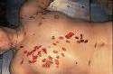
EXPOSING THE WOUND
Expose area around the wound, unless in a CBRN environment
Remove, cut, or tear clothing
DO NOT remove stuck clothing
DO NOT clean wound or remove objects from the wound
If the casualty has multiple wounds affecting the same lung, apply an occlusive dressing to all wounds.

Slide 12
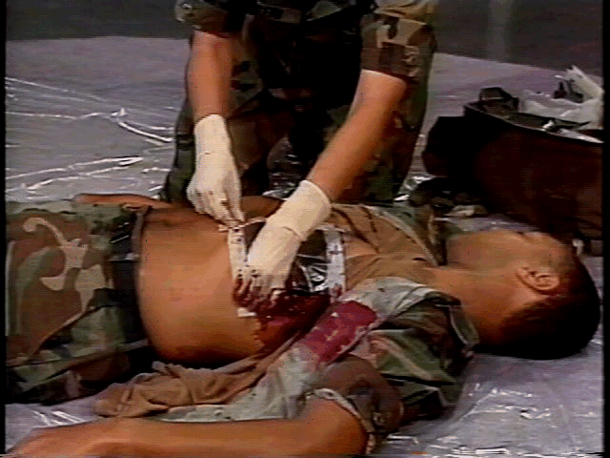
SEAL THE WOUND Using an Improvised Seal
Open the dressing wrapper
Have the casualty exhale and hold their breath
Apply and tape airtight material over wound and advise the casualty to continue breathing
Occlusive dressing must extend at least 2 inches over wound edges in all directions
Tape wrapper down on all FOUR edges

Slide 13
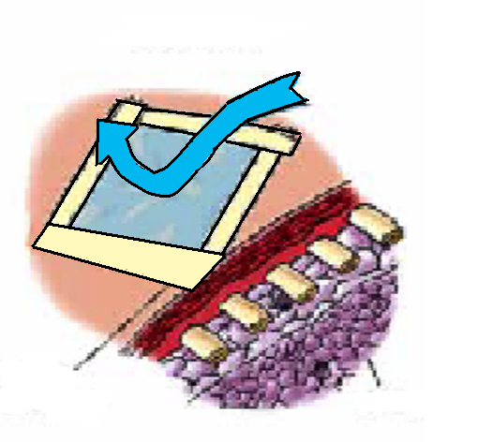
SEAL THE WOUND

Slide 14
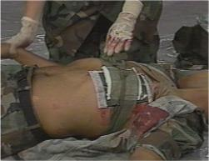
SEAL THE WOUND Using an Improvised Seal
Dress the wound
Using a casualty’s field dressing or Emergency Trauma Bandage (ETB)
Tie knot on top/center of dressing

Slide 15
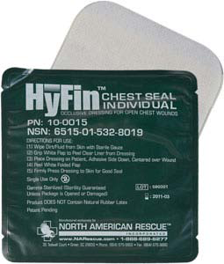
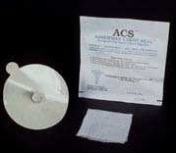
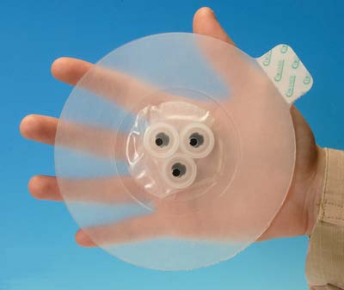
SEAL THE WOUND
Hyfin®
ACS
Bolin®

Slide 16
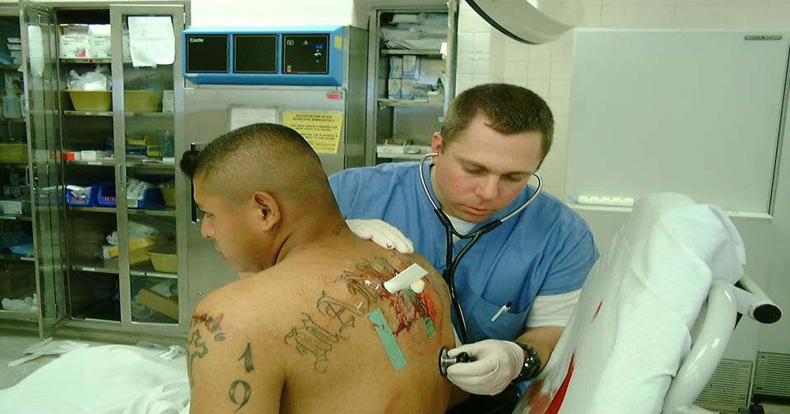
SEAL THE WOUND
ACS

Slide 17
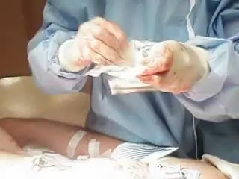

Slide 18
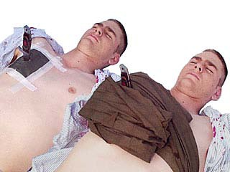
SEAL THE WOUND With an Impaled Object
One problem you may
encounter is an object protruding from the wound.
For instance, an explosion may have propelled a small broken tree limb with enough force to penetrate a casualty’s chest.

Slide 19
IMPALED OBJECT
Place occlusive material around the impaled object.
Use bandaging material to build up and stabilize the impaled object to keep it from moving.
Do not attempt to remove the object!

Slide 20
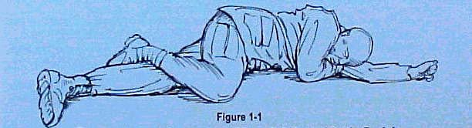
POSITIONING
Position the conscious casualty wound side down or sitting up.
Place an unconscious casualty in the recovery position or wound side down.

Slide 21
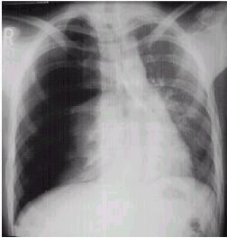
SIGNS & SYMPTOMS
You must be alert to the possibility of tension pneumothorax whenever a casualty has a penetrating chest wound.

Slide 22
TENSION PNEUMOTHORAX
Tension pneumothorax occurs when the air in the chest continues to accumulate, builds up pressure, and cannot escape.
This condition results in increasing danger to the casualty's respiratory and cardiovascular system (heart and major blood vessels).
RESULTING IN DEATH!

Slide 23
SIGNS & SYMPTOMS
Anxiety, agitation and apprehension
Diminished or absent breath sounds
Increasing difficulty in breathing
Cyanosis
Rapid, shallow breathing
Distended neck veins
Low blood pressure
(evidenced by loss of radial pulse)

Slide 24
SIGNS & SYMPTOMS
Cool, clammy skin
Decreased level of consciousness
(AVPU scale)
Visible deterioration
Loss of Consciousness
Tracheal Deviation (shift of the windpipe)

Slide 25
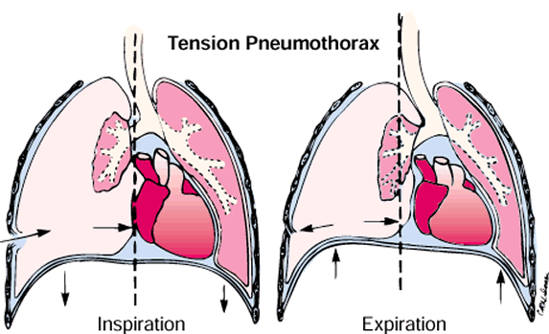

Slide 26
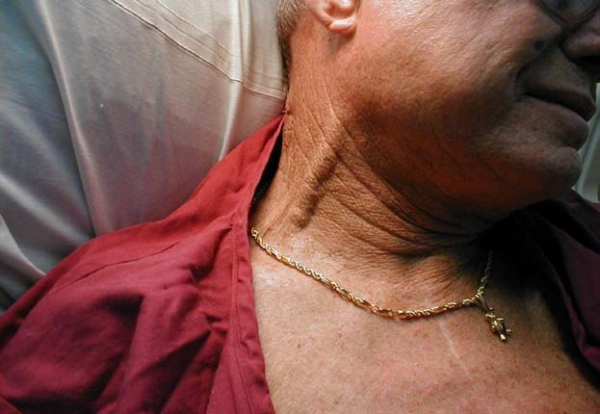
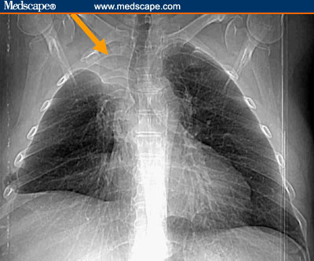
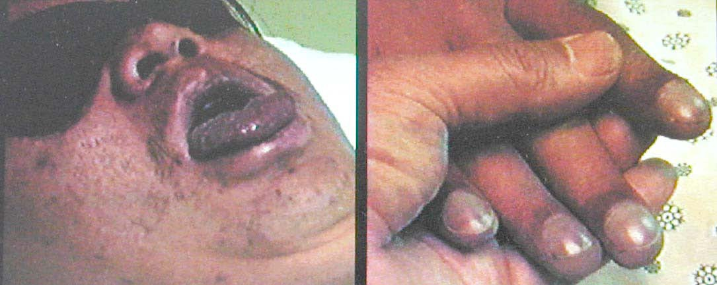
SIGNS & SYMPTOMS

Slide 27
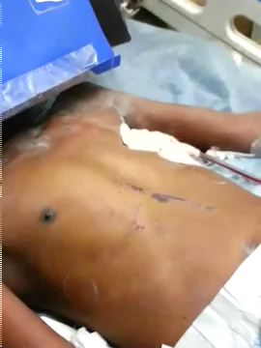

Slide 28
NEEDLE CHEST DECOMPRESSION
The buildup of trapped air in the casualty's chest can be relieved by puncturing the chest cavity with a needle and catheter unit; allowing the trapped air under pressure to escape.
A needle chest decompression is performed ONLY if the casualty has torso trauma and progressive trouble breathing.

Slide 29
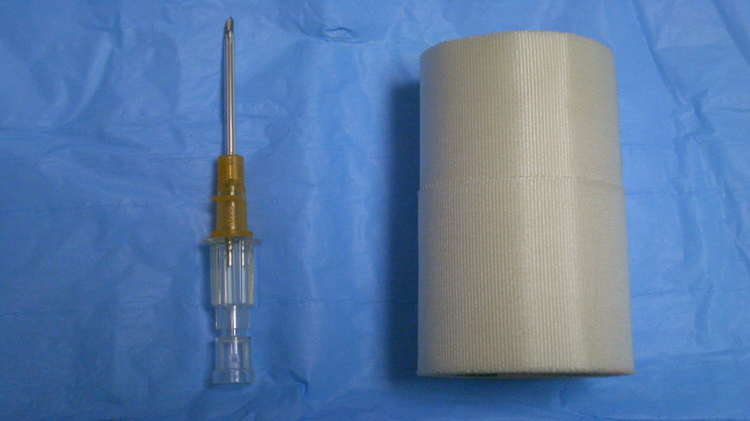
NEEDLE CHEST DECOMPRESSION
Gather Materials
Large Bore Needle/Catheter Unit
Tape
Alcohol Prep Pad

Slide 30
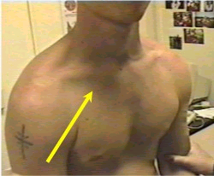
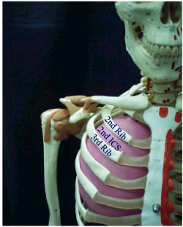
NEEDLE CHEST DECOMPRESSION
Locate Insertion Site

Slide 31
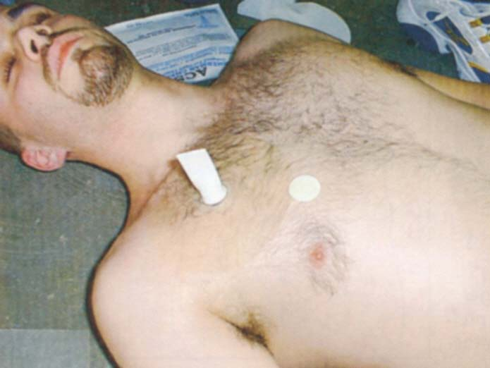
NEEDLE CHEST DECOMPRESSION
Decompression Lines
STERNUM
MID CLAVICULAR LINE

Slide 32
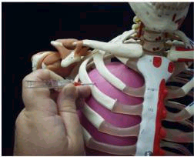
NEEDLE CHEST DECOMPRESSION
Insert Needle
Second Intercostal Space just above the 3rd rib at a 90° angle

Slide 33
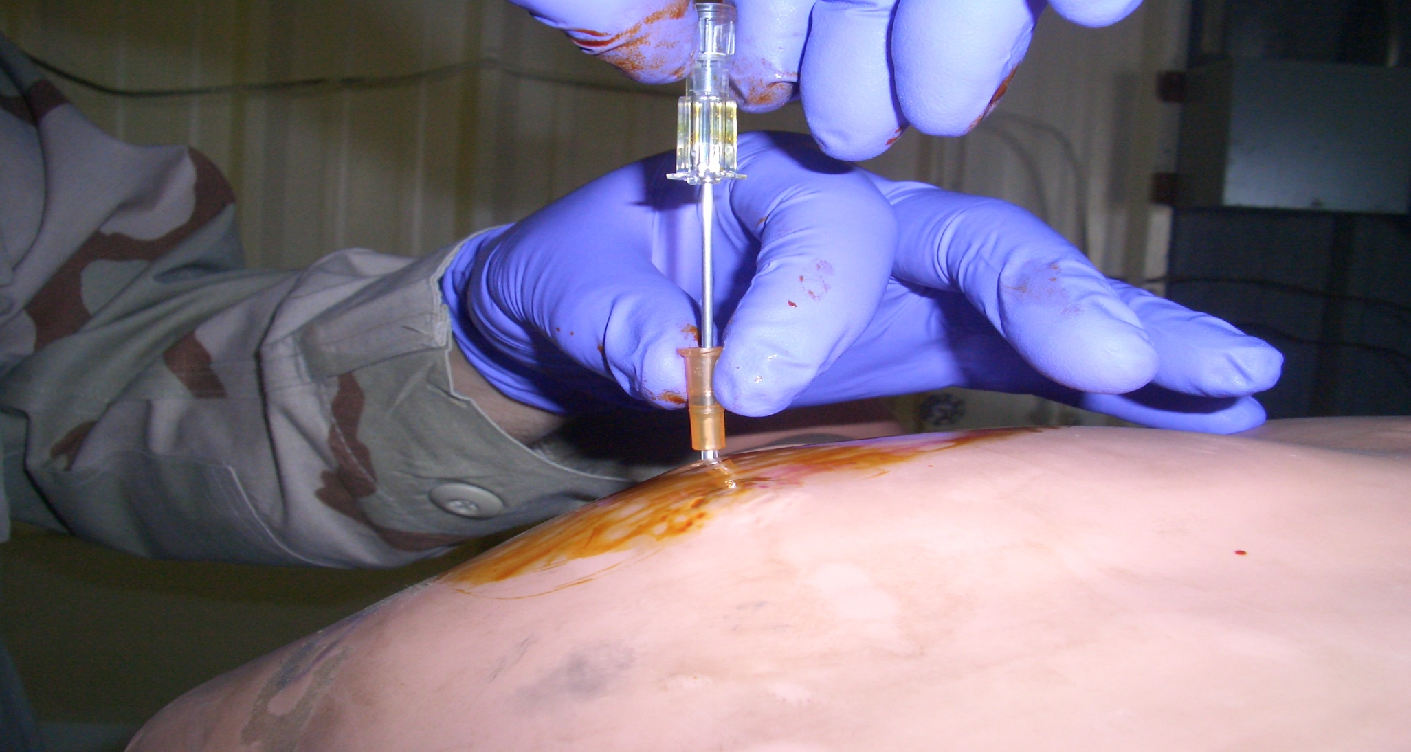
NEEDLE CHEST DECOMPRESSION
Withdraw Needle while holding the catheter in place.

Slide 34
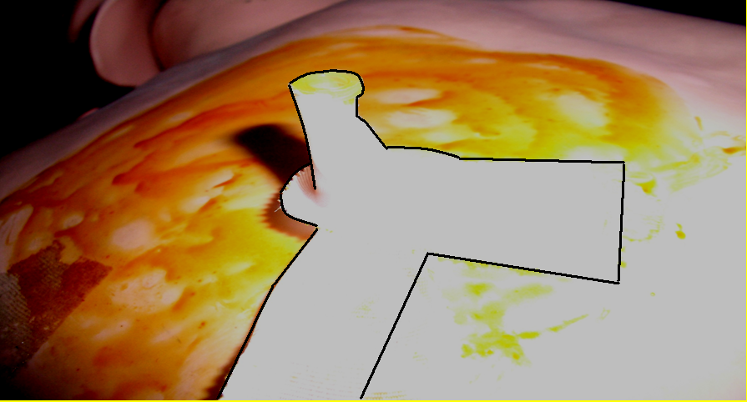
NEEDLE CHEST DECOMPRESSION
Secure the Catheter
Use tape to
secure the
catheter hub
to the
chest wall
“SUPPORT THE TROOPS”

Slide 35

NEEDLE CHEST DECOMPRESSION

Slide 36
POSITIONING
When the casualty is evacuated, they can be positioned:
On his side with the injured side down
In a sitting-up position if the casualty finds that position more comfortable and is conscious enough to hold onto the litter.

Slide 37
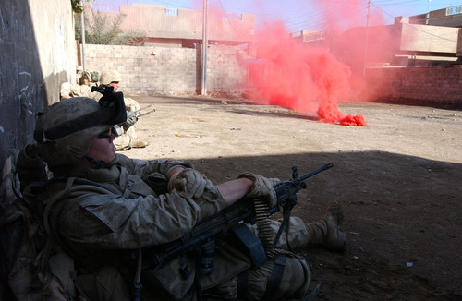
NEEDLE CHEST DECOMPRESSION
MONITOR
TRANSPORT

Slide 38
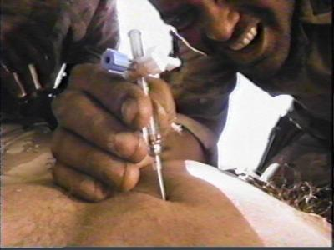
QUESTIONS?

